Slide 1
Jermyn Borough Council Meeting
09/18/2025

Slide 2

Meeting Agenda
SEPTEMBER 18, 2005
Call to order
Pledge of allegiance
Roll call
Previous meeting minutes
Treasure report/bills payable
Correspondence
Secretary's report
Public comment
Artisan fire company
Building/zoning permit procedure
Professional reports
Committee reports
Monroe County LSA grant resolution
Police pension plan resolution
On-Lot Sewage (Septic) permit resolution
Sewage facilities certification
Jermyn Historical Society grand opening
Code enforcement
Open council seat
Trash removal bid specs
New business
Adjournment

Slide 3
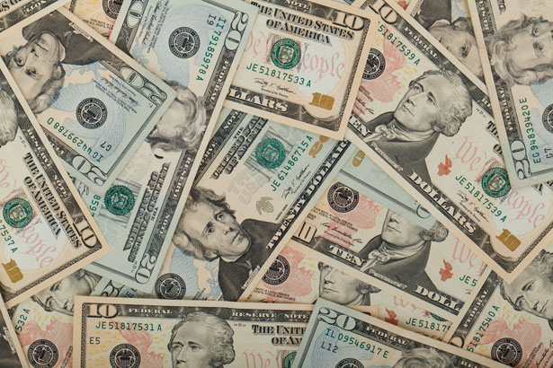
Treasurer’s report
9/18/2025
ASSETS
Checking/Savings
American Rescue Plan Fund 92,596.44
Capital Reserve - DPW 1,118.80
Capital Reserve - Police 6,869.82
Crime Watch Fund 222.69
General Fund - Community 110,589.87
General Fund - FNB 4,160.89
Holiday Lights Fund 400.59

Slide 4
Treasurer’s report
Investment - General Fund 1,153.63
Investment - Liquid Fuels 25,400.27
Investment - Paving Fund 1,165.62
Investment - Recycling 127.38
Investment - Refuse 181.66
Liquid Fuels - FNB 41,479.22
Petty Cash 194.00
Recreations Fund 28,522.80
Recycling - Community 8,486.87
Refuse Checking - FNB 264,245.64
Total Checking/Savings 586,916.19

Slide 5
Treasurer’s report
200000 · Accounts Payable 59,831.02
Long Term Debt None

Slide 6


